Slide 1

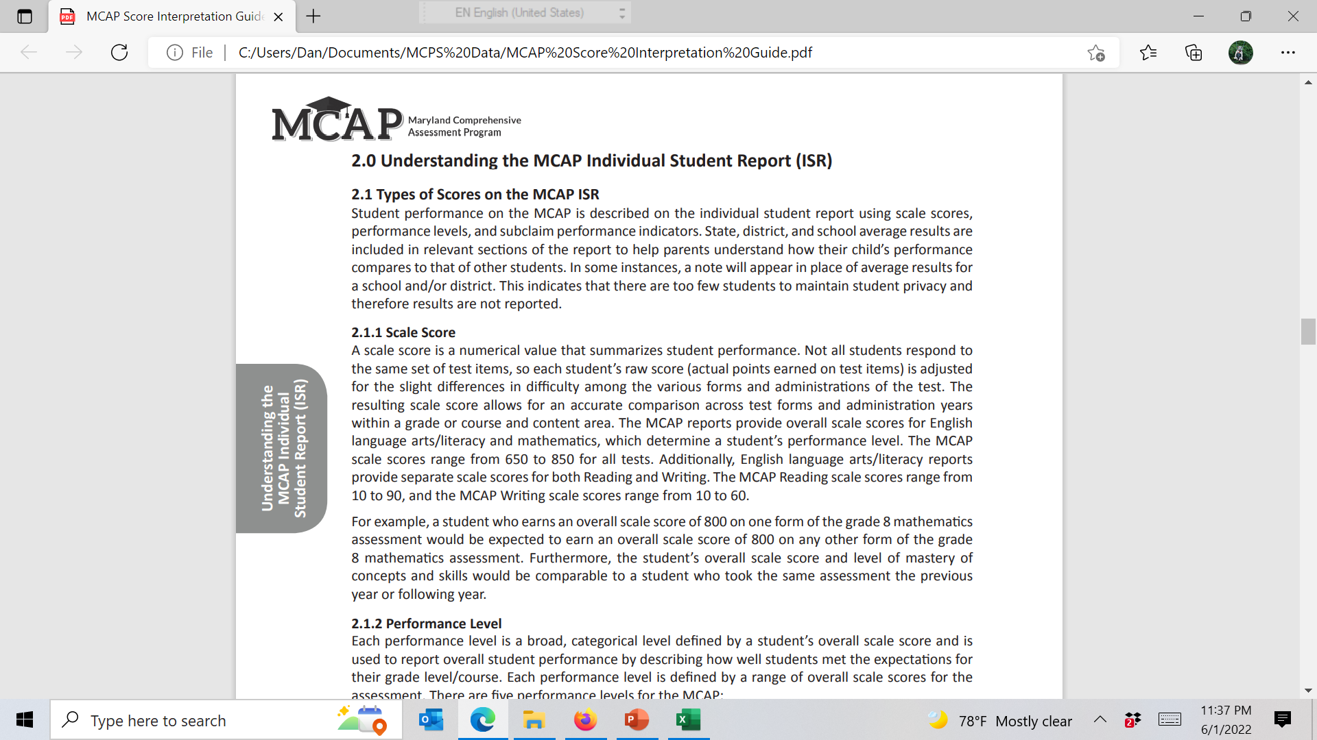
Frederick County Public Schools
Maryland Comprehensive Assessment Program
Preliminary Results 2021

Slide 2

2021 MCAP PRELIMINARY SUMMARY
ALL ACADEMIC SUBJECTS
OVERALL AVERAGE PERCENT PROFICIENCY
*
Ϯ
֍
Ϯ Ave = County-Level Grand Average Percent Proficiency calculated by summing each MCAP Subject Assessment percent proficiency test score in the County, divided by the total number of tests administered County-wide for that Subject Assessment
Wt Ave = County-Level Weighted Grand Average Percent Proficiency calculated by multiplying each MCAP Assessment percent proficiency score by the number of proficient students tested for each Subject Assessment, divided by the total number of students tested County-wide for that Subject Assessment.
֍

Slide 3
2021 MCAP PRELIMINARY SUMMARY
ENGLISH LANGUAGE ARTS
OVERALL AVERAGE PERCENT PROFICIENCY
*
*
Overall Average = County-Level Grand Average Percent Proficiency calculated by summing each grade-specific MCAP ELA Assessment percent proficiency test score in the County, divided by the total number of MCAP ELA tests administered County-wide for that specific-grade.

Slide 4
2021 MCAP PRELIMINARY SUMMARY
MATHMATICS
OVERALL AVERAGE PERCENT PROFICIENCY
*
Ϯ
Ϯ
Overall Average = County-Level Grand Average Percent Proficiency calculated by summing each grade-specific MCAP SCI Assessment percent proficiency test score in the County, divided by the total number of MCAP SCI tests administered County-wide for that specific-grade.

Slide 5
2021 MCAP PRELIMINARY SUMMARY
ELEMENTARY & HIGH SCHOOL SCIENCE
OVERALL AVERAGE PERCENT PROFICIENCY
*
*
Overall Average = County-Level Grand Average Percent Proficiency calculated by summing each grade-specific MCAP SCI Assessment percent proficiency test score in the County, divided by the total number of MCAP SCIENCE tests administered County-wide for that specific-grade.

Slide 6
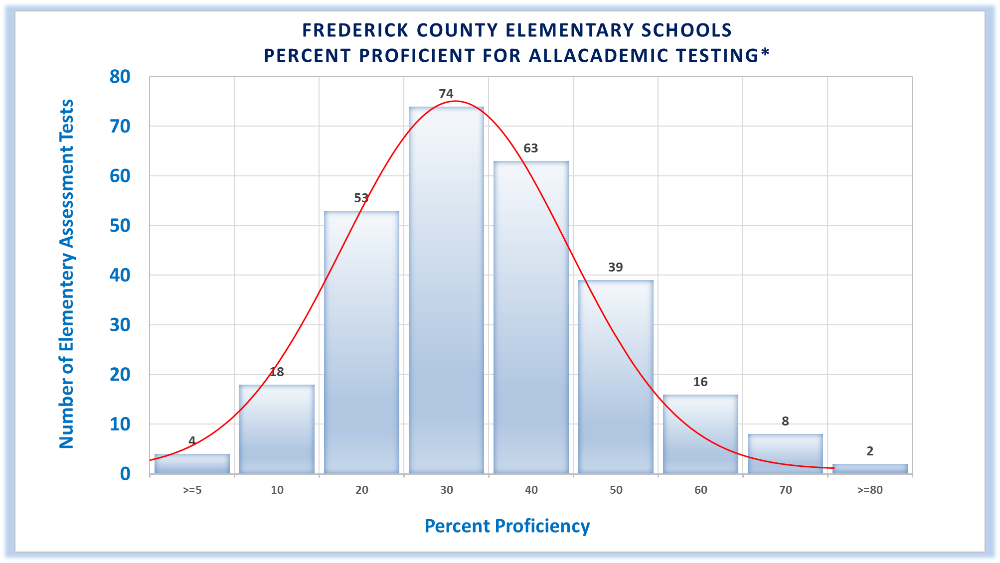
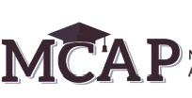
68% of FCPS Grade School Student tests failed to score at grade level in 2021*
AVERAGE PERCENT PROFICIENCY DISTRIBUTION
Frederick County Public Elementary Schools
*2021 MCAP Results: Of 11,457 Grade School student tests, only 3,719 or 32% scored at or above grade level.
273 out of 277
ELEMENTARY
MCAP Tests
administered in 2021, recorded an average grade level proficiency of less than 70%.

